Slide 1


Sports Performance Monitoring & Event Management Platform
A User-Friendly Web Application for Monitoring Sports Performance & Managing Events
OUR MENTOR & GUIDE : Ms. Shireesha T.
Batch 2
1. Swastik Behera
2. Lakshmi Manasa
3. Armaan Ahmed Mubarki
4. Vijay Jose

Slide 2

AGENDA
Problem Statement
Solution Overview
Use Case Diagram
Data Flow Diagram
Technology Stack Used
Future Scope
Thank You

Slide 3




Problem statement
Managing sport events manually has several key challenges:
Inefficiency
Limited Scalability
Prone to Data Issues
Security Risks
Poor User Experience

Slide 4




SOLUTION OVERVIEW
A web-based platform to streamline sports event management, offering a complete solution for admin, athletes, and coaches.
features :
Role-Based Access
Event Management
Athlete Registration
Coach Supervision
Result Publishing

Slide 5


USE CASE DIAGRAM
User Registration / Login
Profile Creation & Management
ATHLETE
Meet Creation
Event Registration
Event Creation & Management
Athlete Registration Management
ADMIN
Coaching Assistance
COACH
Result Publication
Dashboard & News

Slide 6
Data Flow Diagram
User
Register
Create Meets
Create Events
Login
Check Credential using JWT
Publish Results
Admin
Shortlist Candidates
Logout
Event Registration
Check Role
Athlete
Request Coaching
Viewing Result
Check Event History
Coach
Check All Requests
Approve/Deny Request

Slide 7






Tech STACK used
Backend:
Spring boot
JWT
MySQL
Frontend:
HTML, CSS, JavaScript
Bootstrap
Development tools:
Postman
Git

Slide 8
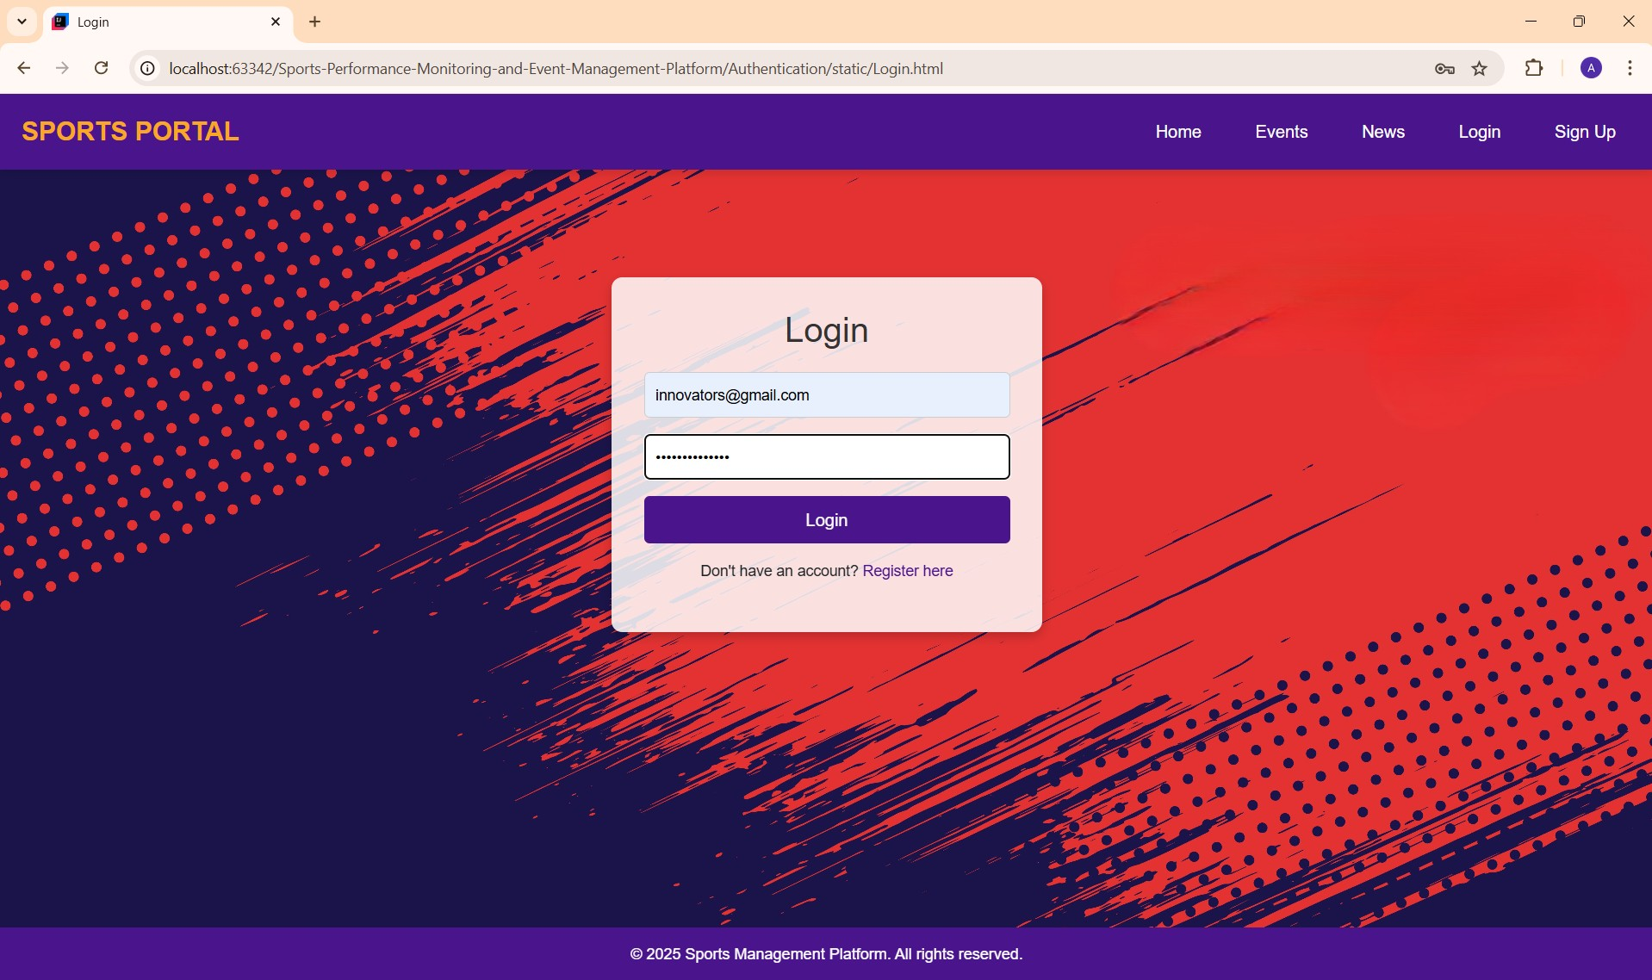
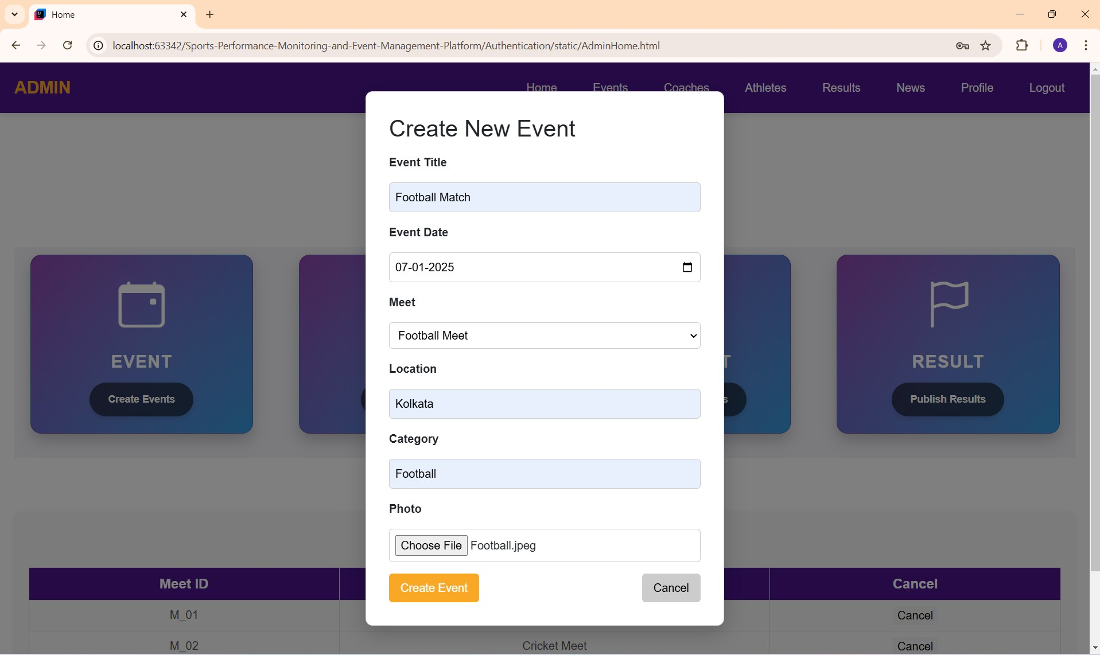
SOME Significant Features

Slide 9
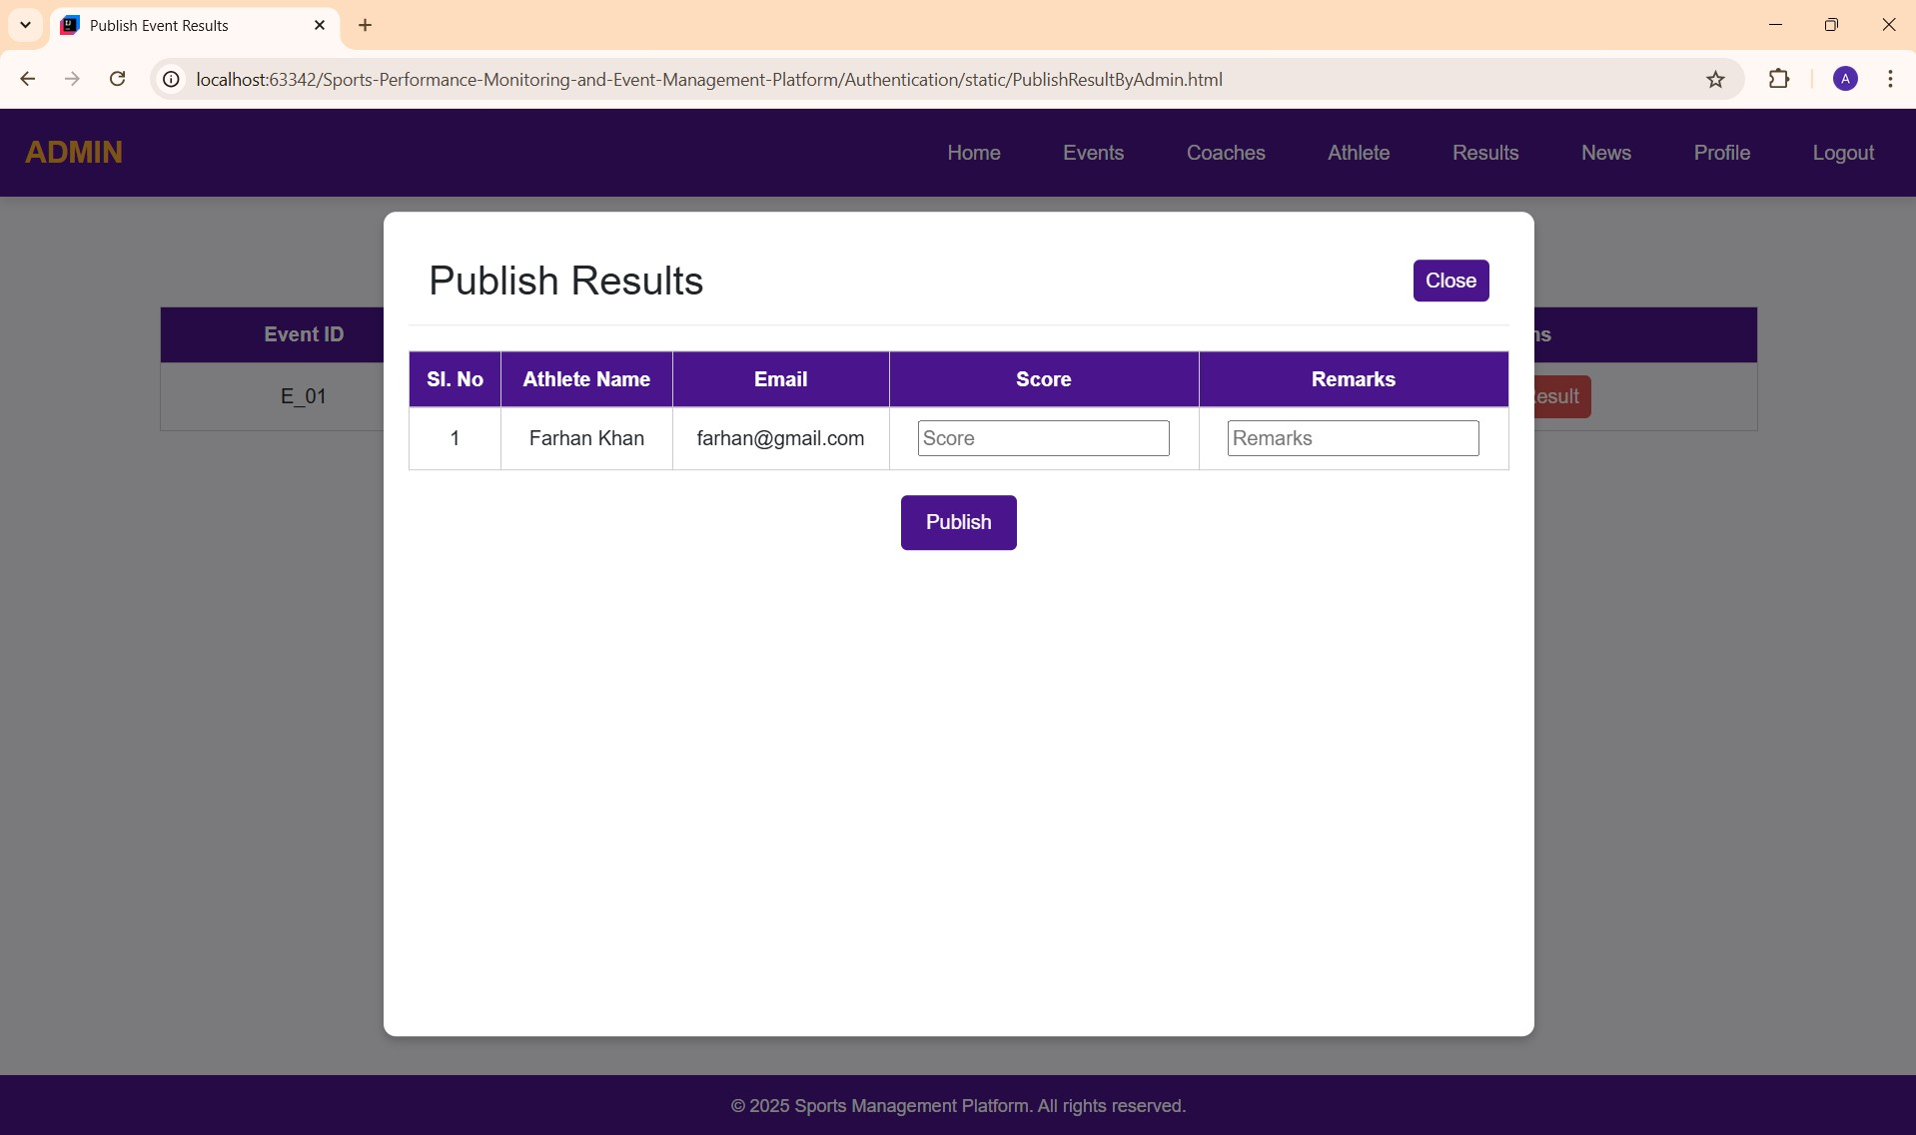
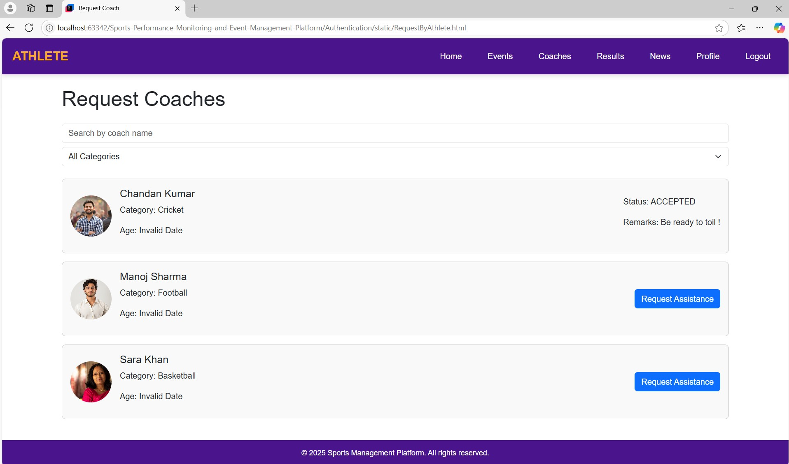
SOME Significant Features

Slide 10

Future scope
Support for Multi-Language & Accessibility
Mobile App Development
Integration with Wearable Devices
Gamification
Global Scalability

Slide 11


